Slide 1

AI-Driven Morse Code Translation System
Group members:
AAKASH.G.S(CB.SC.U4AIE24101)
NEERAJ.T(CB.SC.U4AIE24141)
NIHTIN AARYA(CB.SC.U4AIE24142)
PUNEETH KUMAR(CB.SC.U4AIE24146)

Slide 2

Contents:
Introduction
Literature Review
Research Gaps
Problem Statements
Importance
Objective
Components used
Workflow
Block diagram
Challenges faced
Future improvements
Conclusion
Reference

Slide 3
Introduction:
What is Morse Code?
Morse Code is a method of encoding text characters using sequences of dots (·) and dashes (–).
It was developed in the 1830s by Samuel Morse and Alfred Vail.
Each letter, number, or symbol is represented by a unique combination of short and long signals.

Slide 4
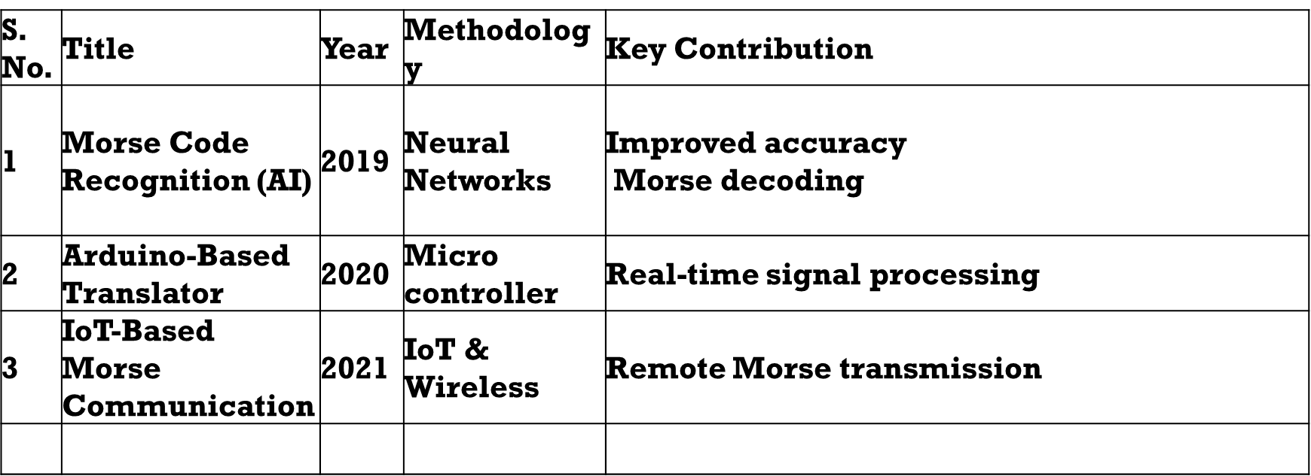
Literature Review:

Slide 5

Research Gaps:
- Lack of real-time web-based Morse code translators.
- Limited integration with assistive technologies for visually or hearing- impaired individuals.
-Limited bidirectional Morse code conversion (most tools focus only on encoding or decoding)
- Absence of a user-friendly, interactive interface for learning Morse code.

Slide 6
Problem Statement:
-The project aims to develop a Morse Code Translator that enables real-time
translation of Morse code to text.
- It will integrate software (UI) and hardware (Arduino) to provide both
visual and auditory feedback.

Slide 7
Why is Morse Code Important?
Early Communication: It was the foundation of long-distance communication before telephones.
Used in Telegraphy: Enabled real-time communication across continents using telegraph wires.
Military and Aviation: Still used in emergencies where voice communication fails.
Universal and Simple: Can be sent using light, sound, or touch — even with basic tools like a flashlight or tapping.

Slide 8
Objective:
Objective of the Project
To design and develop a Morse Code Translator that can convert Morse to text using a simple and interactive interface.
To develop a user-friendly web-based interface for Morse code translation.
To implement real-time translation between text and Morse code.

Slide 9
How Morse Code Works
Morse Code uses dots (·) and dashes (–) to represent characters.
Each letter, number, and symbol has a unique Morse code.
Dot (·) = short signal Dash (–) = long signal
Letters are separated by a short pause, words by a longer pause.
Example:
SOS = · · · – – – · · ·
A = · –
B = – · · ·

Slide 10
Components Used
1. ESP32 Microcontroller
2. Push Button
3. Buzzer

Slide 11
Workflow of the Project
1. User Input
User presses the button to input Morse code.
Short press = Dot (·)
Long press = Dash (–)
Time gaps define letter and word boundaries.
2.Signal Detection by ESP32
ESP32 detects duration and timing of button presses.
Identifies whether it’s a dot, dash, or space.

Slide 12
3. Morse to Text Conversion
Morse → Text: ESP32 decodes button input into readable text.
4. Output Handling
For Morse output:
Buzzer plays sounds (short/long beeps).
For decoded text:
ESP32 sends translated message via WiFi.

Slide 13
User Input via Button
ESP32 Detects Press Type
Convert Morse <-> Text Based on Mode
Output to Buzzer + Send Data via WiFi
Display Result on Mobile Screen
Block Diagram

Slide 14
Challenges Faced:
Detecting Accurate Button Press Duration:
Differentiating between a dot (short press) and dash (long press) required precise timing logic.
Had to handle debouncing to avoid false signals from the button.
2. Timing Gaps for Letter and Word Separation
Detecting when a letter ends vs. when a word ends was tricky.
Required careful timing thresholds between presses.
3. Synchronizing Output
Synchronizing the buzzer output with Morse timing (dot, dash, gaps) was essential for clarity.
Sound durations had to be consistent and distinguishable.

Slide 15
Future Improvements:
Voice-to-Morse Conversion
Use a microphone or speech recognition module to convert spoken words into Morse code.
Makes the system more accessible and hands-free.
2. Multiple Language Support
Add support for encoding/decoding Morse for other languages (e.g., Hindi, Spanish).
Could use Unicode-compatible Morse tables.
3. SOS/Emergency Mode
Pressing the button in a certain pattern can automatically send an SOS signal.
Useful in remote or offline emergency scenarios.

Slide 16
Conclusion:
This project successfully demonstrates a Morse Code Translator using the ESP32 microcontroller.
It allows users to:
Convert input Morse code using a button, and translate it back to text.
The output is displayed wirelessly on a mobile phone via WiFi, making the system portable and user-friendly.
Through this project, key skills were developed in:
Embedded systems
Hardware-software integration
This system has potential for real-world applications in education, emergency signaling, and assistive communication.

Slide 17
Reference:
https://ieeexplore.ieee.org/document/7556055
https://ijarcce.com/papers/morse-code-decoder-using-arduino/

Slide 18
Thank You

